Slide 1
Clustering in Global Development Measurement
Analyzing Patterns and Groupings in Development Data
Group no. :2
Date: 27-07-2024

Slide 2
What is Clustering?
Definition:
It is a process that groups similar items together, or separates items with different characteristics into different groups
Importance in data analysis:
Clustering also known as cluster analysis , where it can help researches identify patterns between data elements and reveal Structures that might not have been obvious before.

Slide 3
Types of Clustering
Hierarchical Clustering
Partitioning Clustering (e.g., K-means)
Density-based Clustering (e.g., DBSCAN)
Applications in Various Fields:
1.Market segmentation,
2. Social network analysis,
3. Medical imaging.

Slide 4
Global Development Measurement
Key Indicators:
-> Economic indicators (GDP, employment rates),
->Social indicators (education, healthcare),
-> Environmental indicators (carbon emissions, biodiversity)

Slide 5
Why Use Clustering in Global Development?
Benefits:
Identifying patterns and trends, Grouping similar countries/regions, Enhancing comparative analysis
Examples:
Grouping countries by economic performance, Clustering regions by health Outcomes.

Slide 6
Exploratory Data Analysis (EDA)
Purpose of EDA:
Understanding data distribution and characteristics, Identifying missing values and outliers
Techniques:
Summary statistics, Visualization (histograms, scatter plots, box plots), Correlation analysis

Slide 7
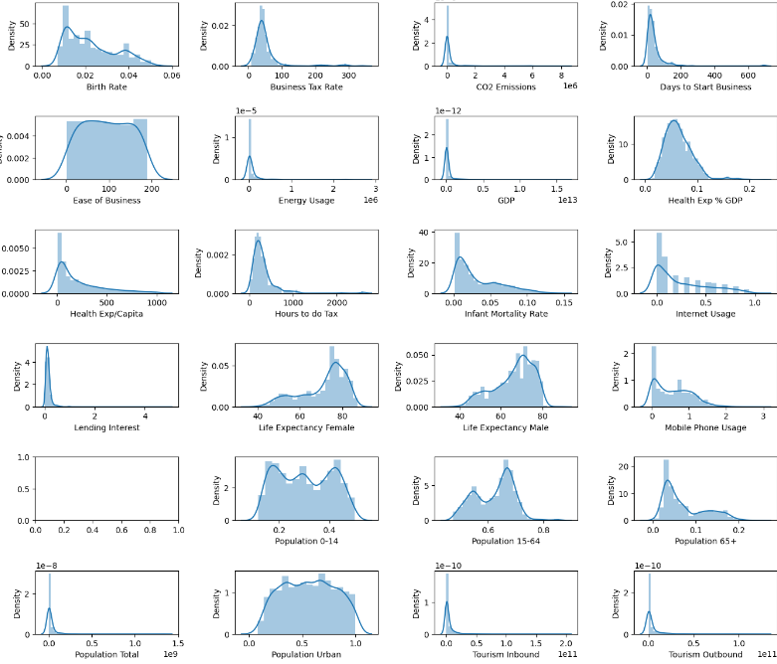
Visualization of given dataset

Slide 8
Data Preparation
Data Cleaning:
Handling missing data, Removing duplicates
Feature Engineering:
Creating new features, Normalization and standardization

Slide 9
Model Building
Choosing a Clustering Algorithm:
-> K-means,
->Hierarchical Clustering,
->DBSCAN
Implementation Steps:
Selecting features, Setting parameters (e.g., number of clusters for K-means), Running the algorithm

Slide 10
K-means Clustering
Overview of K-means Algorithm:
It works Choosing the number of clusters (K)
Example Application:
Clustering countries by economic indicators, Visualizing results with scatter plots
Silhouette Score for K-means clustering : 0.281281120 23335633

Slide 11
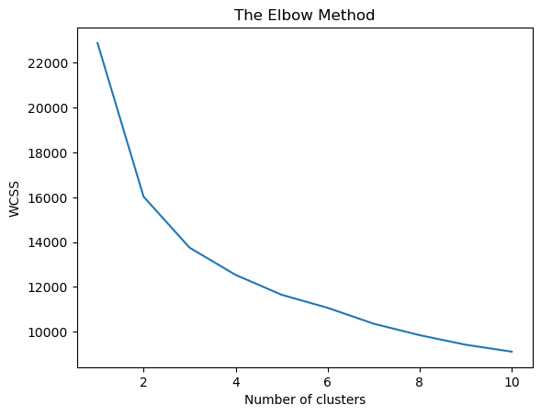
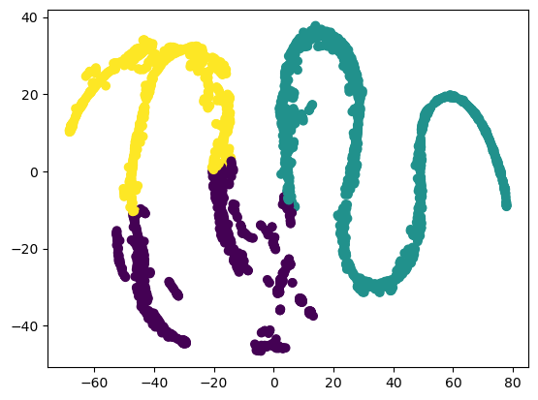
KMEANS
KMEANS is an unsupervised machine learning algorithm , where it partition the data into specific number of groups , where similar data points into one group and dissimilar into the other.

Slide 12
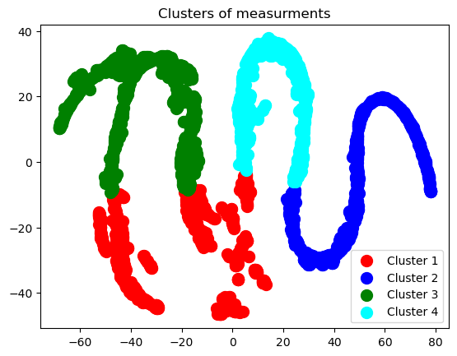
Hierarchical Clustering
Overview of Hierarchical Clustering: Agglomerative vs. Divisive methods, Dendograms interpretation
Example Application:
Clustering regions by healthcare outcomes, Visualizing Dendograms.
Silhouette Score for Hierarchy
clustering: 0.20812026657624785

Slide 13
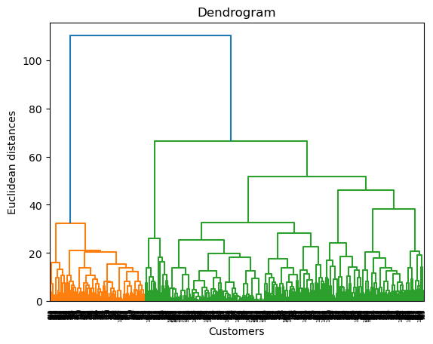
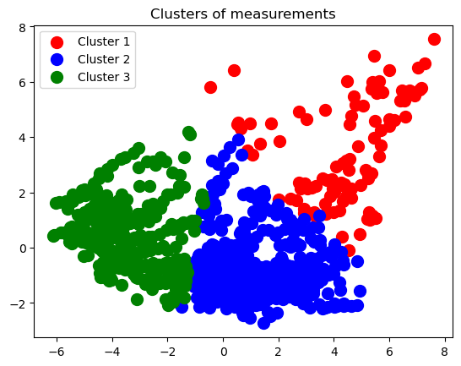
HIERARCHICAL Clustering
It is a popular method for grouping objects in data mining and statistics.it is used for grouping objects into clusters based on similarities.

Slide 14
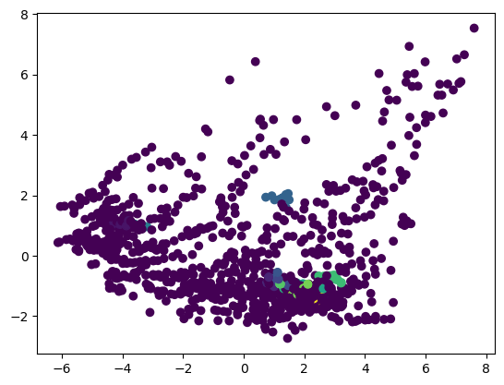
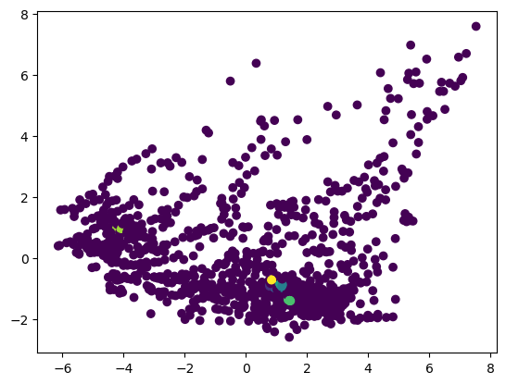
DBSCAN
Density-Based spatial clustering of applications with noise(DBSCAN) is a machine learning algorithm that groups data points into clusters based on their distance to other points. It is used to identify and remove noise in a dataset, making it useful for data cleaning and outlier detection.
Silhouette Score for DBSCAN is: -0.24380431741484504

Slide 15
Model Evaluation
Evaluation Metrics:
Silhouette Score, Davies-Bouldin Index, Inertia (for K-means)
Validation Techniques:
Cross-validation, Comparing different algorithms

Slide 16
Challenges and Limitations
Data Quality and Availability:
Incomplete or biased data, Differences in data collection methods
Algorithm Limitations:
Sensitivity to initial conditions (K-means), Scalability issues (Hierarchical Clustering)
Interpretability:
Difficulty in explaining complex clusters.

Slide 17
Model Deployment
Steps for Deployment:
Model selection and tuning, Integration into decision-making processes, Monitoring and maintenance
Tools for Deployment:
Cloud platforms (AWS, GCP, Azure), API development, Dashboard creation (Tableau, Power BI)

Slide 18
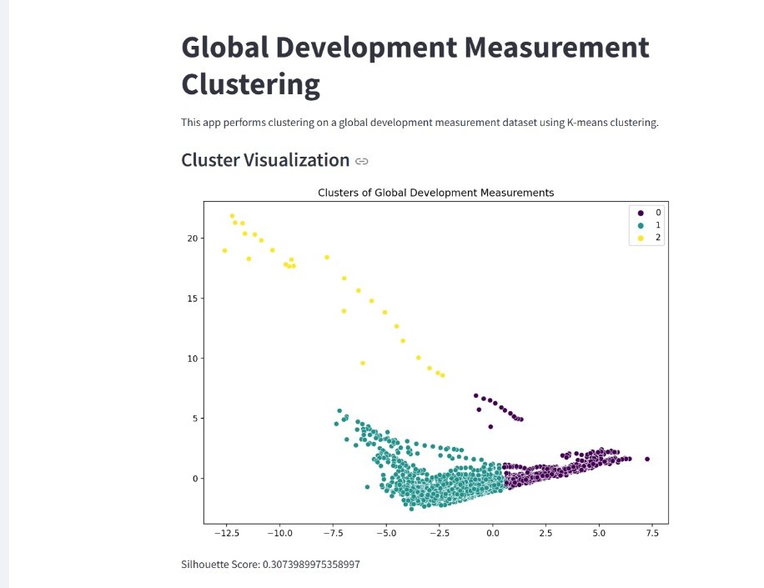
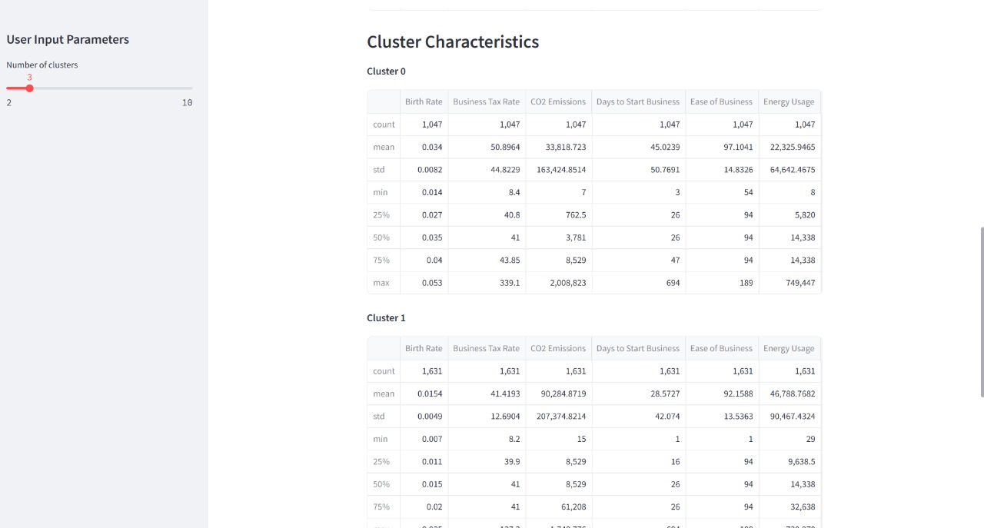
Final outputs of clustering model

Slide 19
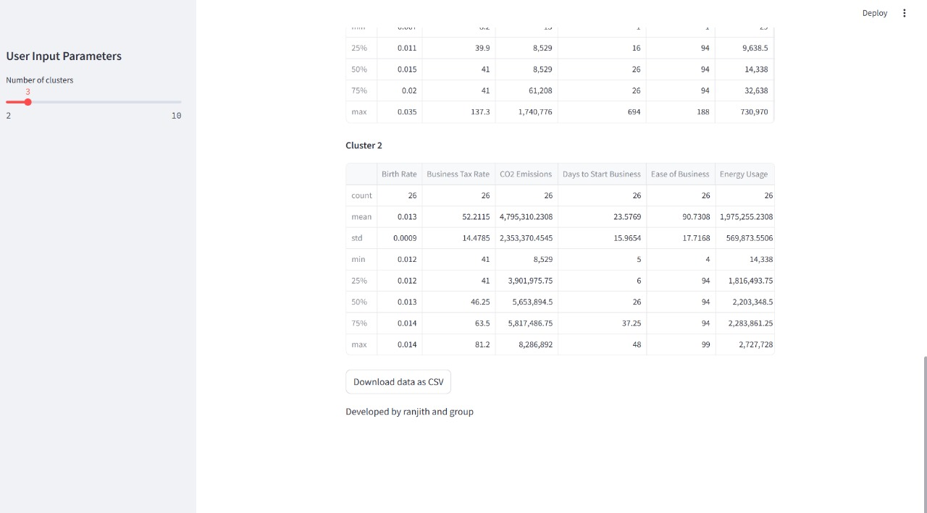

Slide 20
PRESENTED BY GROUP2
THANKYOU

